Slide 1
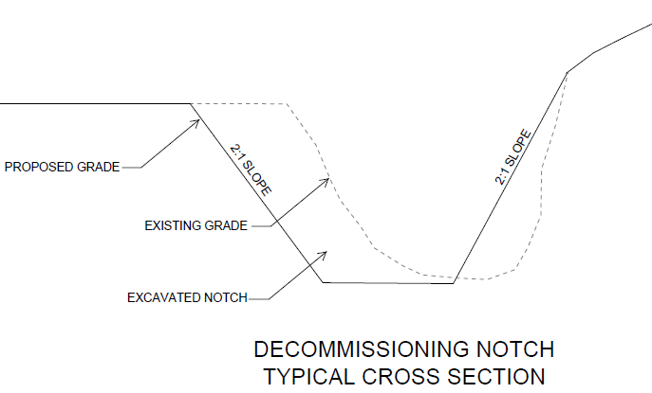
Dam Decommissioning
Excavate notch in the dam to pass 100-yr storm
Grade slopes to a 2:1 slope
Embankment not removed completely
Remove riser and outlet then grout pipe shut
No sediment removal included
Annual Watershed Sediment Produced (Based on Trimble’s 2009 Coon Creek Basin Study)
Total sediment accumulated behind Jersey Valley= 122K tons
Average sediment accumulated behind other structures = 12K tons
WFK Basin = 91K tons
CC Basin = 98K tons
Remove Riser
Embankment
Grout Principal Spillway
Pipe Shut

Slide 2
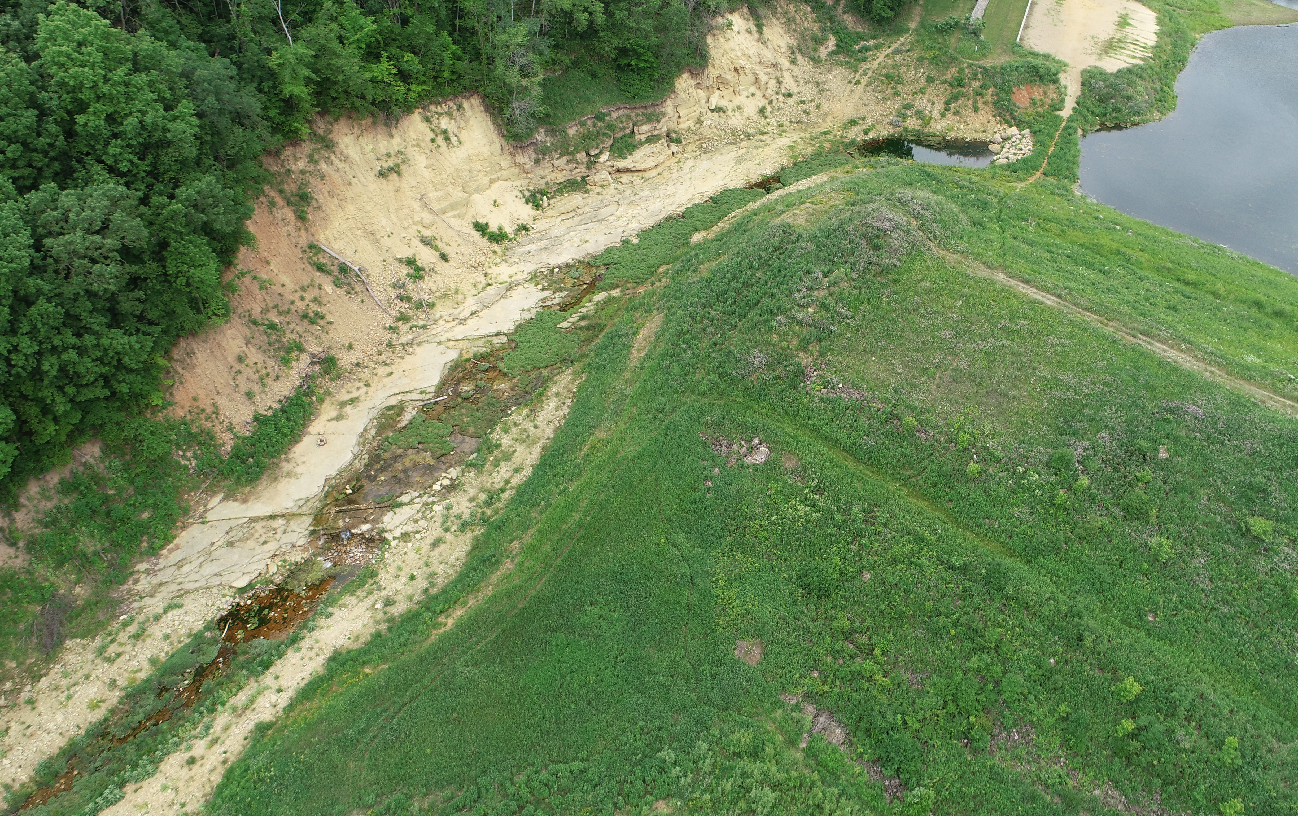
WFK 1 – Jersey Valley
Photo: June 2021

Slide 3
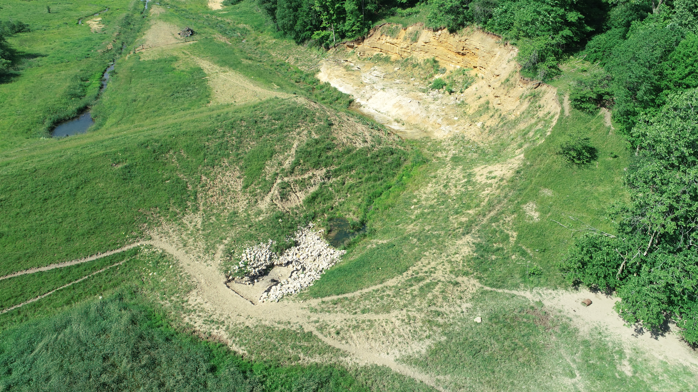
WFK Mlsna
Photo: June 2021

Slide 4
CC 21 – Luckasson
Annual CC Basin Sediment:
98,000 tons
Accumulated Sediment Behind each failed structure:
12,000 tons
Photo: June 2021

Slide 5
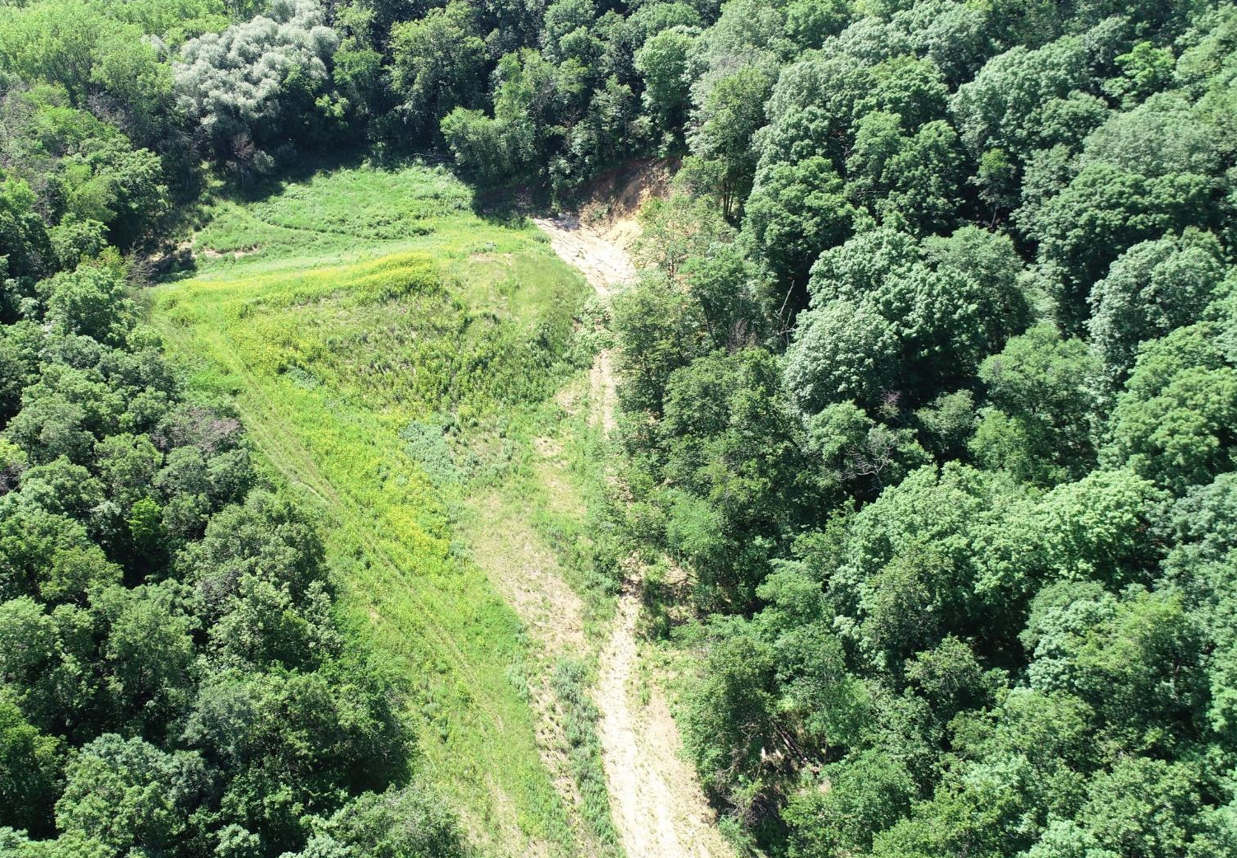
CC 23 – Bilhovde
Annual CC Basin Sediment:
98,000 tons
Accumulated Sediment Behind each failed structure:
12,000 tons
Photo: June 2021

Slide 6
CC 29 – Korn
Annual CC Basin Sediment:
98,000 tons
Accumulated Sediment Behind each failed structure:
12,000 tons
Photo: June 2021

