Slide 1
Coon Creek and West Fork Kickapoo Watersheds
Design Alternatives
Discussion
September 1, 2021

Slide 2
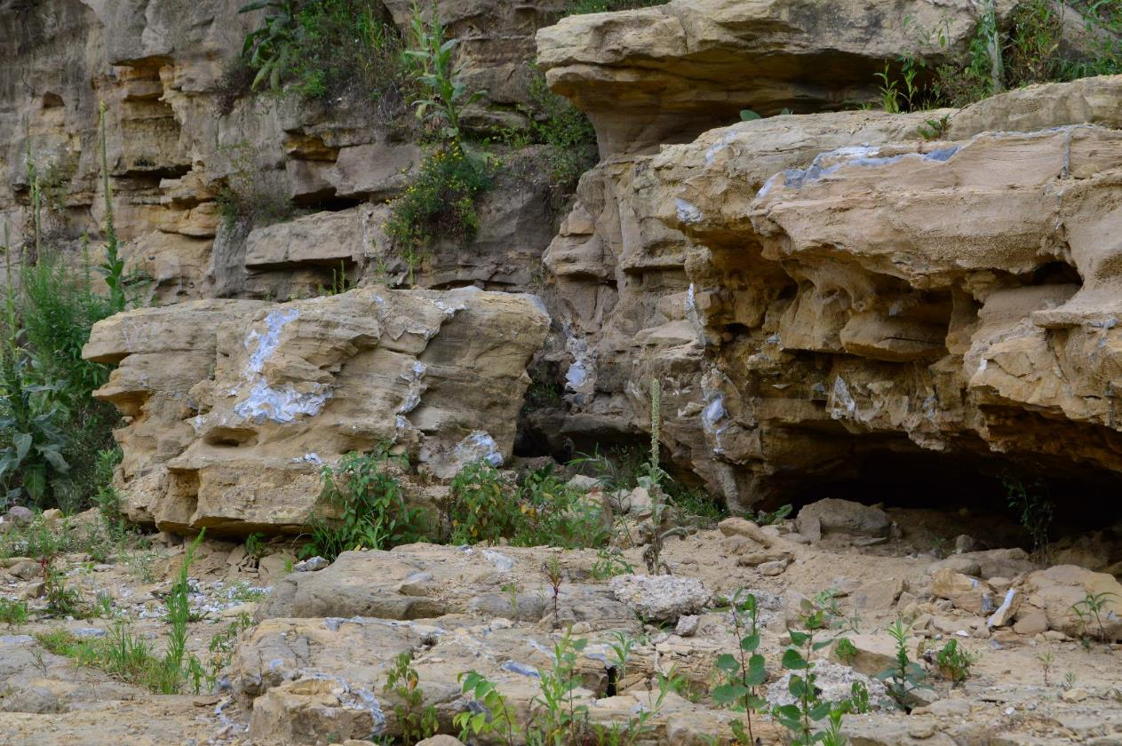
Watersheds Background
Watersheds Geology
Driftless Area (unglaciated area) of western Wisconsin
Highly fractured sandstone susceptible to internal erosion
Coon Creek Watershed
3 of the 14 dams failed in 2018.
West Fork Kickapoo Watershed
2 of the 9 dams failed in 2018.

Slide 3
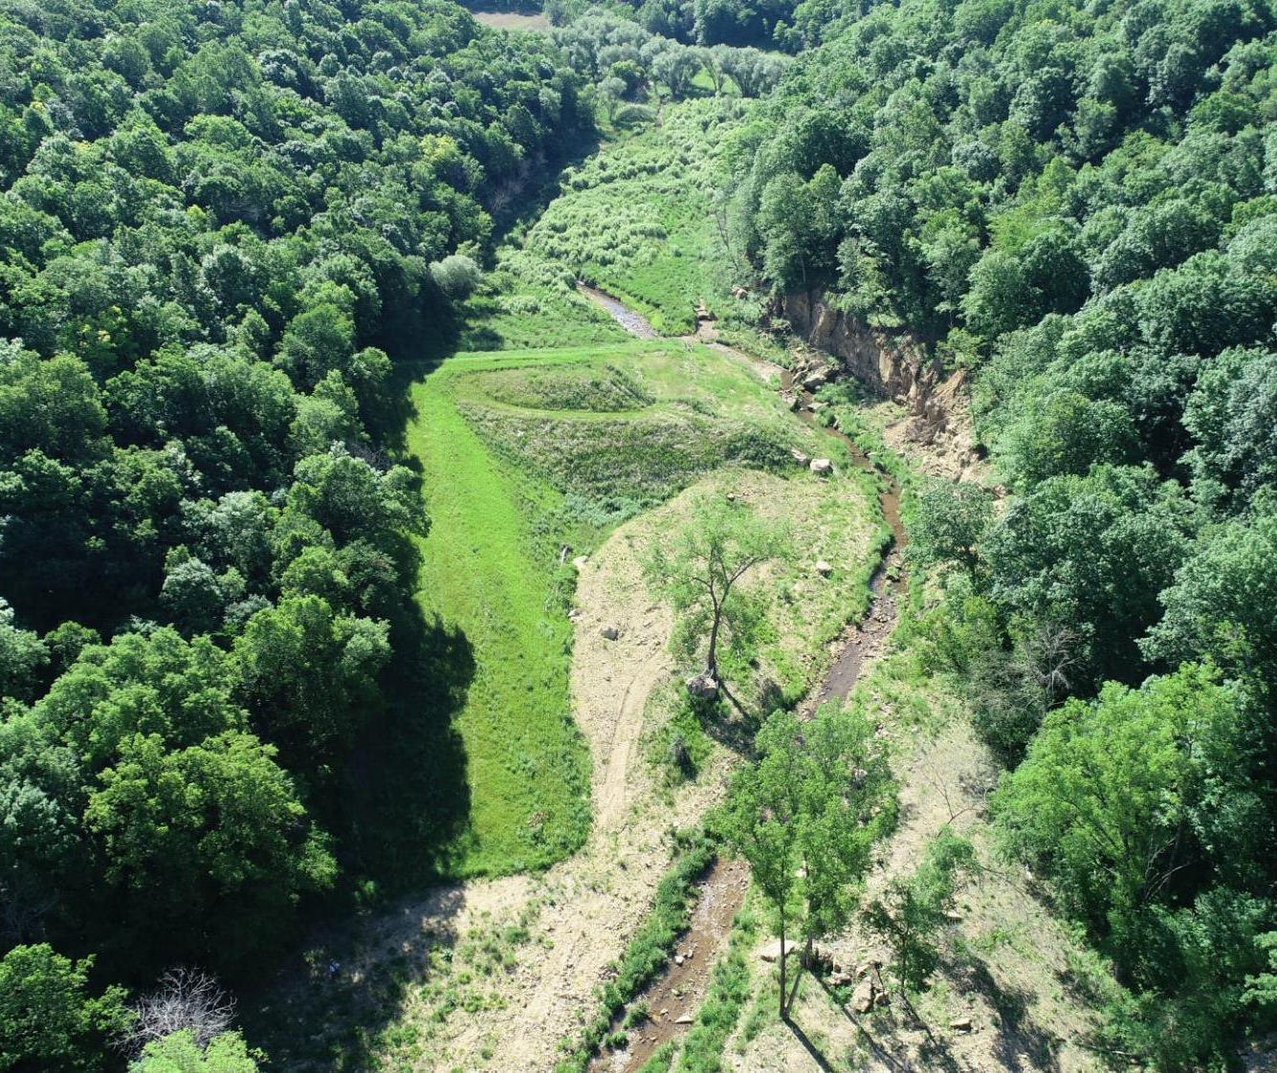
Failed Dams
5 Failed Dams
Dams breached along the interface between the earth-fill and highly jointed Jordan sandstone bedrock.
Breaches extended full depth to the valley floor.
Additional Historic Similar Failures
Coon Creek Watershed Site 41
West Fork Kickapoo Watershed Site 16
Bad Axe Watershed Sites 12 and 33

Slide 4
18 Remaining Dams (Watersheds Combined)
Recently inspected to assess current conditions
Significant deficiencies were identified in most of the dams:
Joint deterioration in the principal spillway pipes
Corrosion of corrugated metal pipes in the foundation drains
Uncontrolled seepage through the dam abutments
Not in compliance with NRCS safety and performance standards
5 high hazard dams remaining
WFK Pilot Klinkner Dam
CC 17 Melby Dam
CC 25 Baltz-Amundson Dam
CC 33 Korn Coulee Dam
CC 41 Dahlen Dam

Slide 5
Alternatives Analyzed
Dam Decommissioning
Dam Replacement
No Federal Action
Dam Repair
Land Use Changes
Small Dams in Upper Watershed
Floodplain Improvements

Slide 6
Alternatives Eliminated
Dam Repair
Not considered a structurally sound alternative due to complex geology
Land Use Changes
Very minimal flood protection provided
Small Dams in Upper Watershed
Very minimal flood protection provided except small storms
Floodplain Improvements
Will not meet purpose need on their own

Slide 7
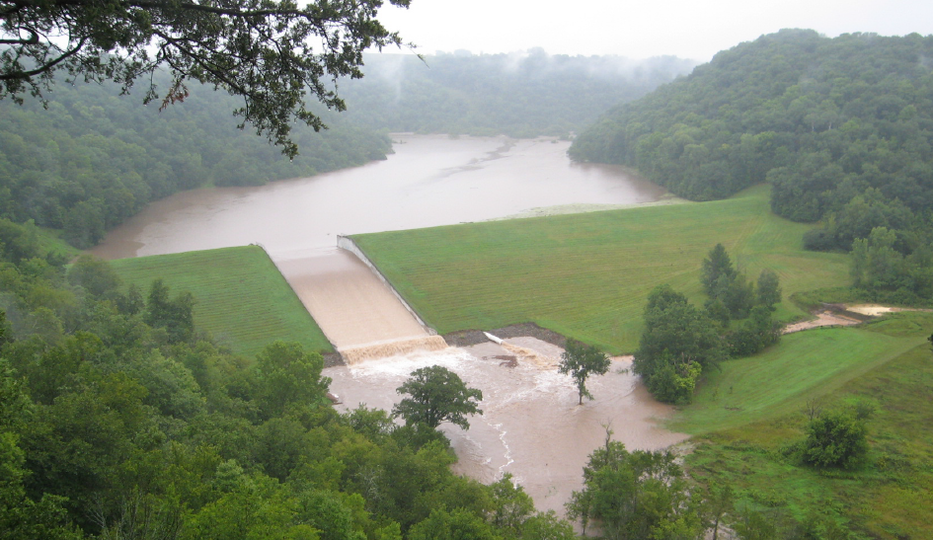
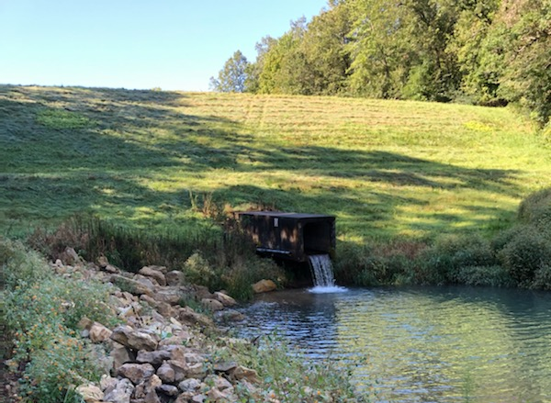
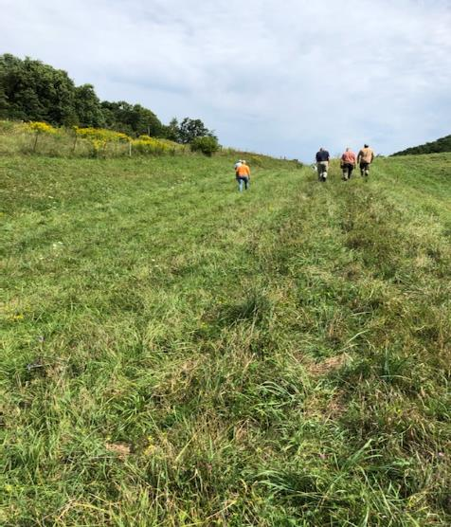
Failed Dam Replacement Downstream
Concrete Auxiliary Spillway
Earthen Embankment
Replace structures immediately downstream
Estimate costs and benefits of remaining based on the failed dams’ analysis
Coon Creek
$58M estimated cost to replace all dams.
Estimated 0.14 B/C ratio
West fork kickapoo
$53M estimated cost to replace all dams.
Estimated 0.09 B/C ratio without Jersey Valley rec benefits
Replacement Design
Earthen Embankment
Earthen Auxiliary
Spillway
Original Design

Slide 8
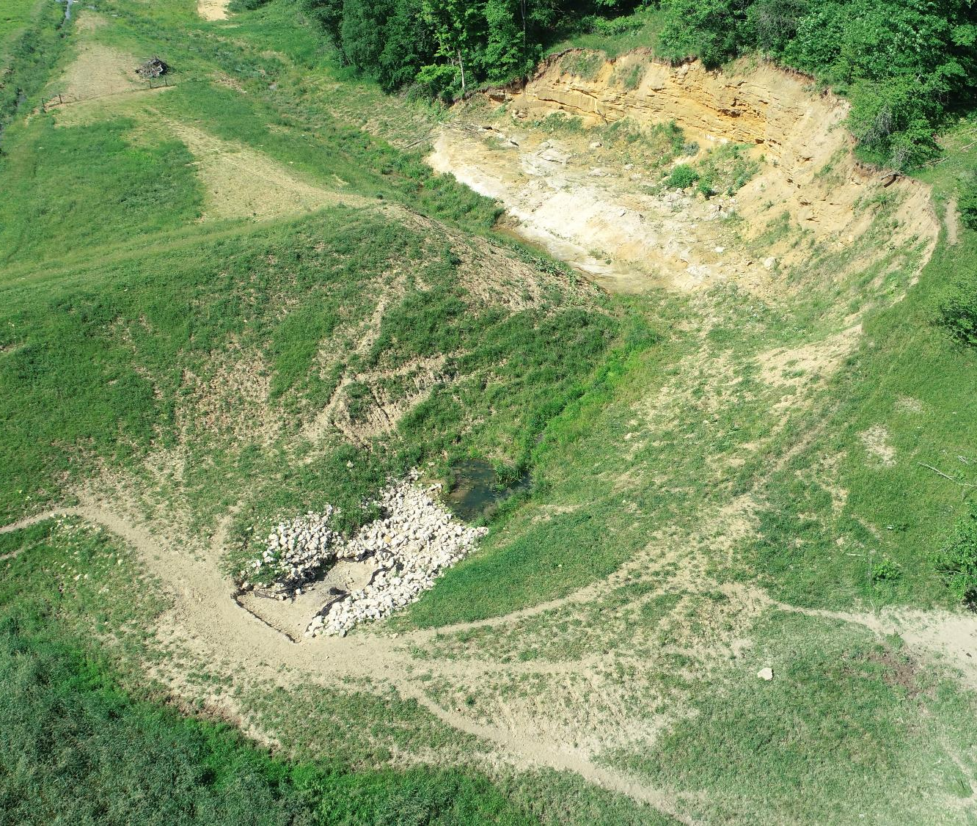
Dam Decommissioning
Excavate notch in the dam to pass 100-yr storm
GRADE SLOPES TO A 2:1 SLOPE
Embankment not removed completely
Remove riser and outlet then grout principal spillway shut
No sediment removal included
Coon Creek
$10M estimated cost to replace all dams.
West fork Kickapoo
$12M estimated cost to replace all dams.

Slide 9
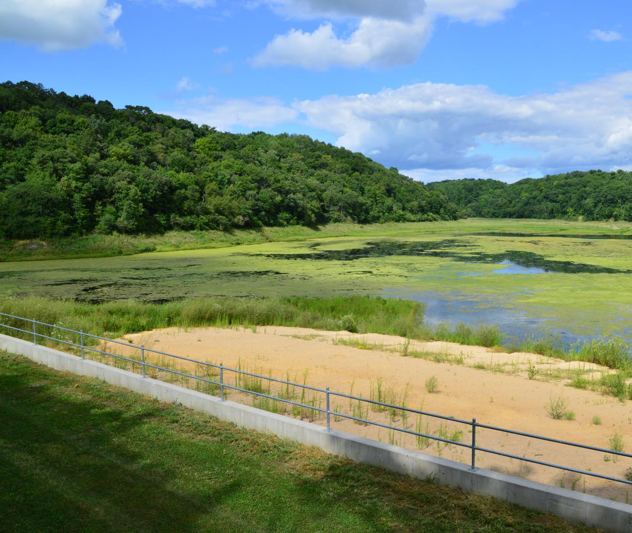
Jersey Valley Outlier
Strong Public support to maintain recreational benefits
$19M Cost
2.9 B/C ratio
Survey showed a shortage of outdoor recreational facilities
53.5 Acre Lake
Uses:
Hunting
Fishing
Kayaking
Beach
Swimming
Hiking
Birdwatching
Bible Camp Use

Slide 10
Public Feedback
Comment Focuses
Flooding
Dams currently provide minimal flood protection
Land and homeowners within the ‘hydraulic shadow’ of the dams cannot escape the consequences of dam failure
Recreation
Strong public support to replace Jersey Valley and maintain recreational benefits
Zoning
Downstream zoning within the former breach inundation area of the failed dams

Slide 11
Alternatives
Coon Creek Watershed
No Action (Future Without Federal Investment) – NRCS would leave structures in their current condition
Alternative 1 – NRCS would replace all 14 dams
Alternative 2 (preferred) – NRCS would decommission all 14 dams
West Fork Kickapoo Watershed
No Action (Future Without Federal Investment) – NRCS would leave structures in their current condition
Alternative 1 – NRCS would replace all 9 dams
Alternative 2 (preferred) – NRCS would decommission all dams except Jersey Valley

Slide 12
Purpose and Need-
Purpose and Need
Evaluate alternatives for three failed dams and eleven remaining dams in the Coon Creek watershed in order to meet the dam safety standards
Action is necessary due to the failure of five dams and the likelihood of similar failures at remaining dams
A breach would risk life and property downstream of dams
The breach flood elevation is higher than the (100-year) regulatory flood elevation.
The dams have completed the Federal interest and exceeded their evaluation period of 50 years.
To satisfy the purpose and need, the selected alternative should:
Be based on best available science and engineering;
Be socially, environmentally, and economically defensible;
Reduce the threat to life and property from future dam failure.

